Slide 1
BFSI: CREDIT RISK ASSIGNMENT
Prepared By:
Archana
Souradeep
Chand Pasha

Slide 2
Objective
Background
Data Analysis
Pre Processing of Data
EDA
Model Building
Interpreting the Results
Recommendations

Slide 3
OBJECTIVE
Predicting Loss Given Default (LGD): The primary business objective is to develop a predictive model for Loss Given Default (LGD) for defaulted accounts. LGD represents the proportion of the exposure that a lender is unable to recover after a borrower defaults. Accurate prediction of LGD is crucial for risk management and financial planning.
Performance Evaluation: Evaluate the predictive model based on a defined performance metric. The performance metric should align with business goals and accurately measure the model's effectiveness in predicting LGD.
Understanding Data Sets: Gain a deep understanding of the provided data sets, including variables, data types, and distributions. Recognize the relevance of each variable to LGD prediction. This understanding is essential for building a meaningful and accurate model.
Data Aggregation and Merging: Aggregate and merge relevant information from the collection data set to enhance the predictive power of the model. The merged data should provide comprehensive insights into the factors affecting LGD.
Data Types and Quality: Ensure accurate identification of variable data types to prevent datatype mismatch errors. Clean and preprocess the data to handle missing values, outliers, or any issues that might negatively impact the model's performance.
Feature Engineering and Extraction: Conduct feature engineering and extraction to create new variables that could enhance the model's predictive capabilities. Introduce features that capture the intricacies of defaulted accounts and contribute to a more accurate LGD prediction

Slide 4
BACKGROUND
Credit risk analytics in the context of the banking sector and model a common metric used for estimating the expected credit loss (ECL)
ECL method is used for provisioning the capital buffer to protect banks against possible default of the customers.
Expected credit loss = Exposure at default x Probability of
Default x Loss given default
The loss given default (LGD) is a measure of the amount of loss that a bank is expected to incur in the event of a default by a borrower

Slide 5
DATA SOURCES
Used 3 Data sets for model Building
The main_loan_base data set contains information about loan accounts and other relevant information for the corresponding borrowers.
The repayment_base data set contains information about the repayments received by the banks in the form of EMIs or through other collection efforts.\
The monthly_balance_base contains the information pertaining to the monthly balance statements in the borrower’s accounts.

Slide 6
PRE PROCESSING OF DATA
For each data set converted Data types if necessary
Null values are handled using deletion and imputation techniques. As well duplicate values are removed from data sets.
Merging the data sets and created target variable(LGD)
Exploratory Data Analysis has been performed
Variable Transformation
Dummy Encoding
Scaling using Standard Scaler

Slide 7
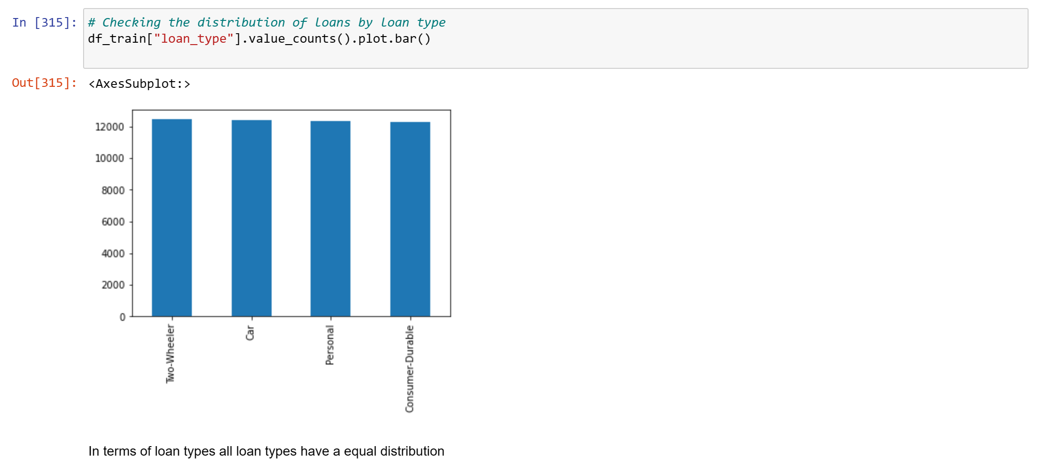
EDA

Slide 8
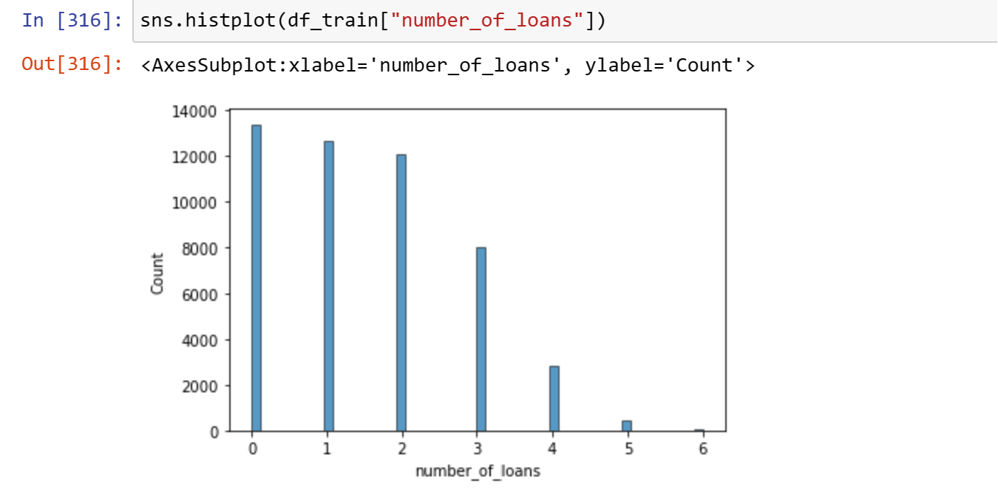
EDA
Majority of customers have 1- 3 loans, which shows that they are living off high credit

Slide 9
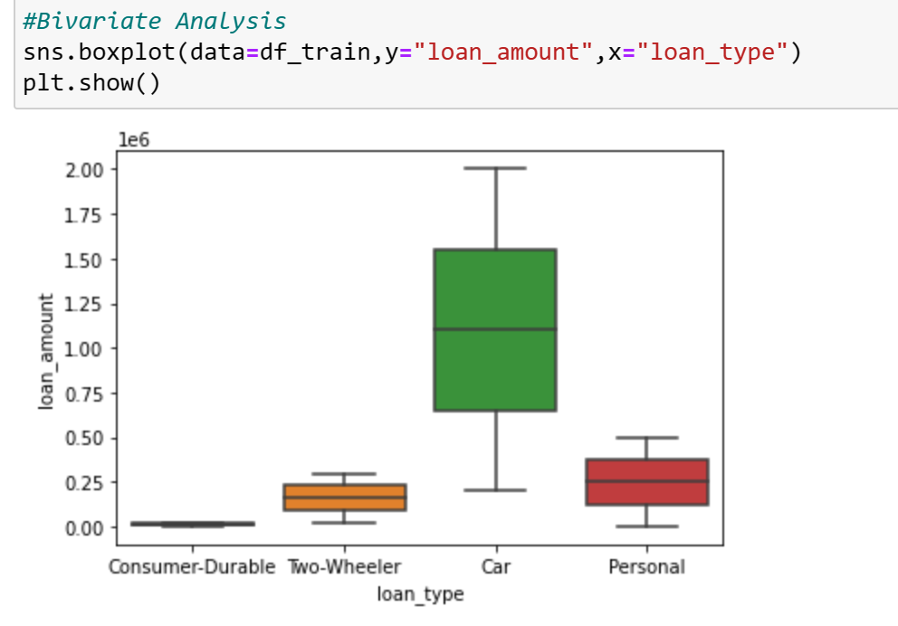
The loan amount for car loans are the highest even though car loans contribute to ~25% of loans

Slide 10
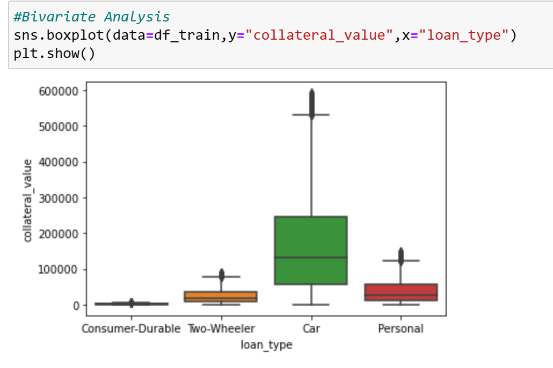
Similar distribution for collateral values show that car loans require higher collateral (e.g. The car itself)

Slide 11
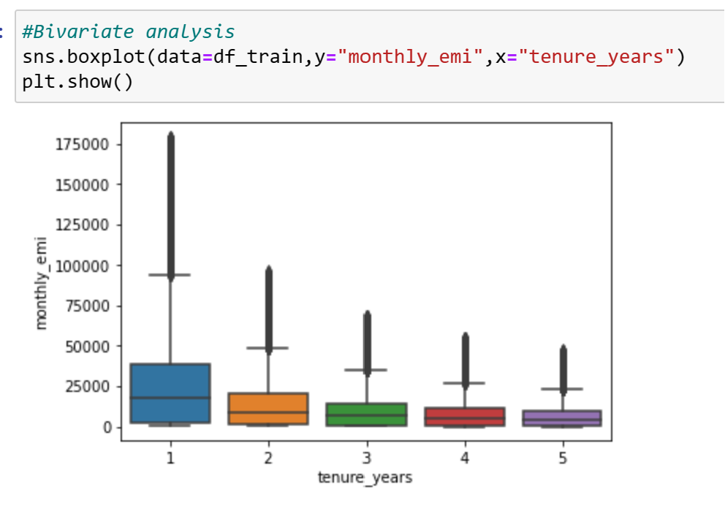
As expected longer loans have lower monthly emi

Slide 12
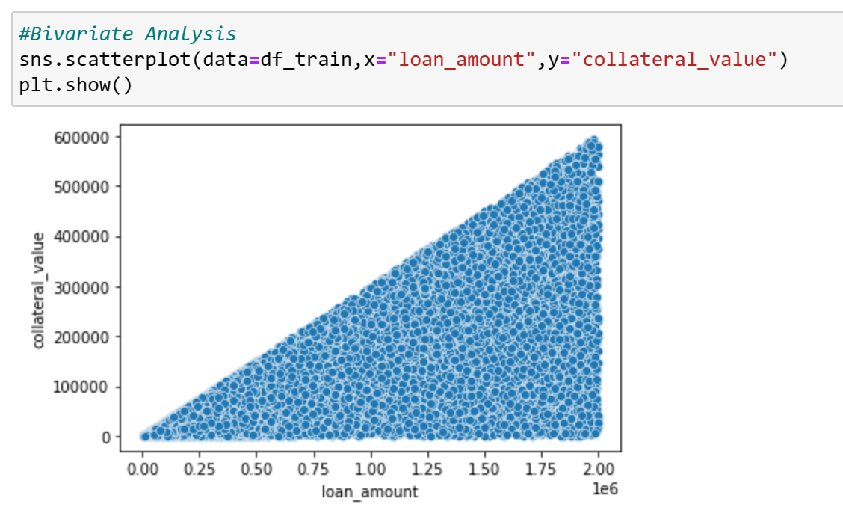
Higher Loan amounts require higher collateral values

Slide 13
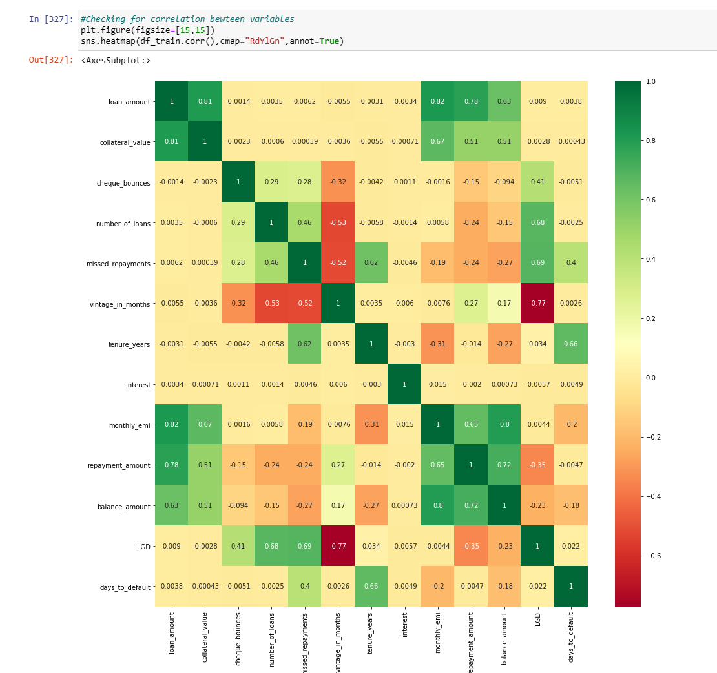
The above matrix shows that: Long term customers have lower missed repayments and lower LGDs which makes them better candidates for loans Higher missed repayments, Number of loans,cheque bounces and LGD are positively correlated which shows that customers which have higher missed payments and #loans tend to greater loss Customers with higher bank balance tend to less loss at default

Slide 14
MODEL BUILDING
Used various models like Multiple Linear Regression, Random Forest Regressor, Residual Analysis of the model
Used R Squared as a performance metrics.
XGBoost has given us 99.5% R squared on test data across the models.

Slide 15
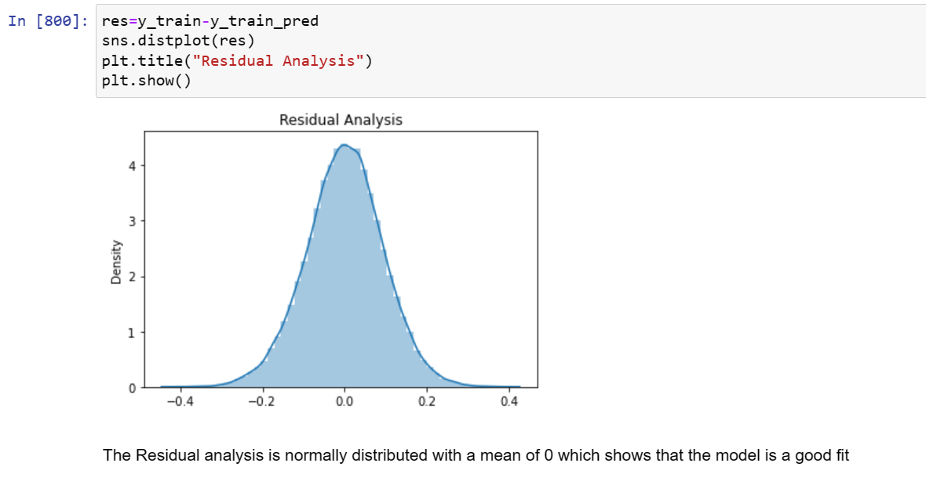
REGRESSION INTERPRETATION
Residual plot of the finest model

Slide 16
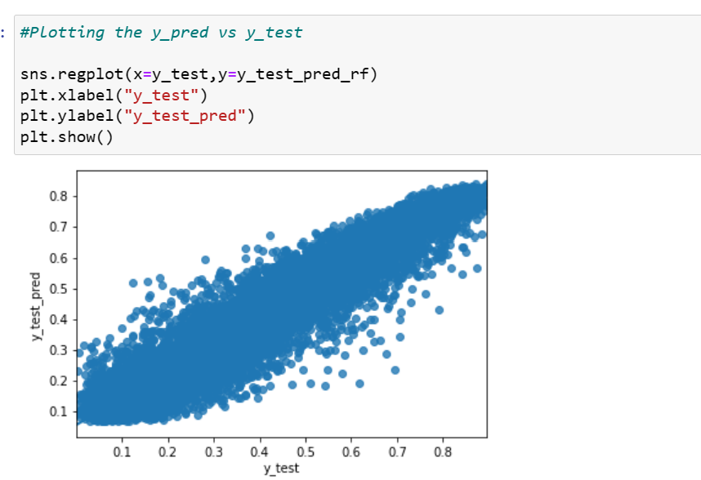
REGRESSION INTERPRETATION
Best fit line corresponding the prediction error

Slide 17
Conclusions
We developed multiple regression models: MLR and RF to calculate LGD
The RF model is a better predictor of LGD with given input variables
We have hyper tuned the parameters of the RF model and the rf_best is what we have selected as final model

Slide 18
Thank you

